Slide 1
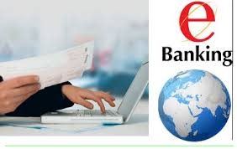
E-BANKING:
“The delivery of new and traditional banking products and services directly to the customer through electronic, interactive communication channels”.

Slide 2
Perspectives of e-banking:
Communication Perspectives
Service Perspectives
Business Perspectives
Online Perspectives

Slide 3
Communication Perspectives:
Customer awareness is very important element and communication is the best tool to keep customer aware:
Several IT products can be used to inform the world about your product:
Personal computers
Personal digital assistant
Automated teller machine
Touch tone telephones
Cellular and smart phones

Slide 4
The advantages of e-banking To the Customers with the communication perspective are:
Quick and steady access to information.
E-banking provides 24 hours service to the customers
Online purchase of goods and services and payments can be made for various purposes.
The customer can view his account balance.

Slide 5
Online Perspectives
Online banking, also known as internet banking, e-banking or virtual banking, is an electronic payment system that enables customers of a bank or other financial institution to conduct a range of financial transactions through the financial institution's website.

Slide 6
Features of online perspective:
1. Safer operation
2. More flexible remittance
3. Increased value of enterprise fortune
4. Easier management
5. Global financial services

Slide 7
Service perspective:
Banks provide the following services electronically:
Account management
Wire transfer
Bill presentation and bill payment
Investment and brokerage services
Loan application and approvals
Account aggregation for individual customer
Business to business payments
Employee benefit and pensions administration for business customer.

Slide 8
Benefit of services:
Following are some of the benefit when various services of bank are delivered online:
Anytime banking, and anywhere banking
Reduction in cost of transaction
Online purchases
Pay bills online thereby save postal services
The services are available seven days a week, 24 hours a day
Easy to make utility payments

Slide 9
Business perspective:
Businesses rely on efficient and rapid access to banking information for cash flow reviews, auditing and daily financial transaction processing.
E-banking offers ease of access, secure transactions and 24-hour banking options.

Slide 10
Features which make e-banking more attractive from business point of view:
Productivity
Lower Banking Costs
Reduced Errors
Reduced frauds

Slide 11
E- BANKING PRODUCTS Smart card Debit card Credit card ATM EFT Telephone banking Mobile banking Sms banking Internet banking etc..

Slide 12
Smart Cards
smart card is a plastic card with an embedded microchip that can be loaded with data, used for telephone calling AND ETC.
Benefit of smart cards:
enhanced security
off line transaction
programmable card
Loyalty
customer information

Slide 13
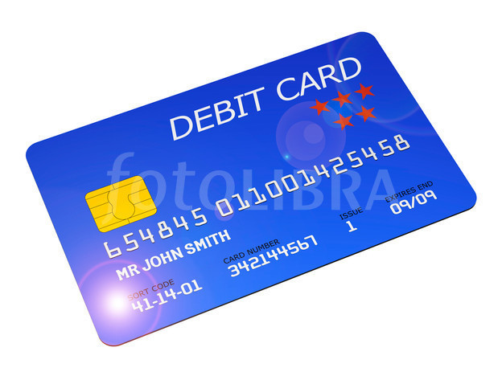
Debit Cards
Debit Card is a “prepaid” or “pay now” card with some stored value.
alternative payment method to cash.
allows customers to obtain the funds directly debited from his bank account.

Slide 14
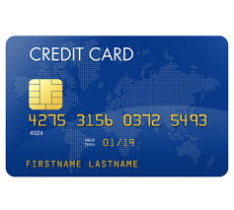
Credit Card
Credit Card is “post paid” or “pay later” card
charged interest
used for short-term financing
cash-free way of buying things

Slide 15
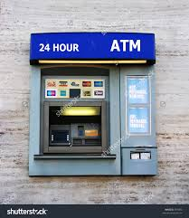
Automatic Teller Machine
access to financial transactions without the need for a cashier
plastic card which contains the customer’s name & account no.
It allows the customers:
To transfer money to and from accounts.
To view account information.
To order cash.
To receive cash.

Slide 16
electronic funds transfer (EFT)
system of transferring money from one bank account directly to another without any paper money changing hands
EFT is safe, secure, efficient, and less expensive than paper check payments and collections.

Slide 17
Alternative Delivery Channels
Anytime, anywhere banking
–Telephone Banking
–Internet Banking
–Mobile Banking

Slide 18
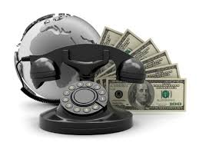
Telephone Banking
banking over phone
Non-Cash related banking over phone
access information by giving PIN
deposit and withdrawal cannot be made over the phone
friendly and effective in nature.
easy way to pay your bills

Slide 19
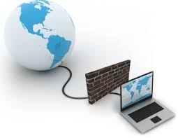
Internet Banking:
It is also known as net banking or Online Banking
It is the process of conducting Banking transactions over the internet.
customer of a bank with a pc can log on to the bank website & conduct basic functions.

Slide 20
Benefits of Internet Banking:
Reducing cost
Increase convenience for customers
Increase customer loyalty
Attract new customers.

Slide 21
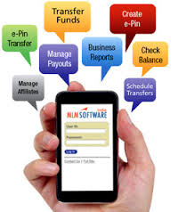
Mobile Banking
It provides a way to pick up information
interact with the banks to carry out the relevant banking business
flexible way of transacting banking business
Deposit checks remotely with your mobile device
Check account balances and transactions

Slide 22
Mobile Banking
Current Mobile Banking Applications:
SMS Banking
WAP Banking

Slide 23
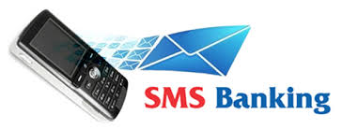
SMS Banking
allows you access to your bank account wherever you are
uses short text messages
. Kept updated on important information
SMS is sent after a certain operation is performed
Security is the main problem

Slide 24
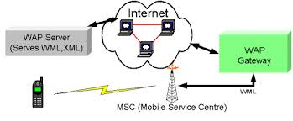
WAP Banking
set of communication protocols for wireless devices designed to enable manufacturer-, vendor
WAP is a global standard and is not controlled by any single company
Various banking transactions offered in WAP environment by banks
Similar architecture with SMS banking

Slide 25
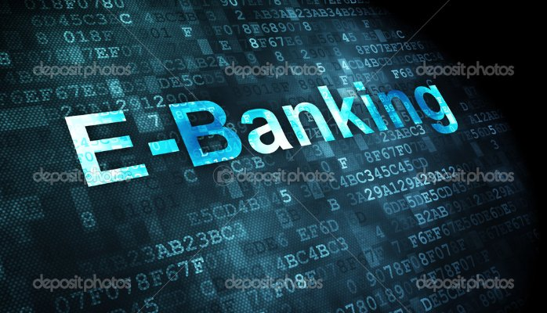
E-Banking Benefits

Slide 26
Convenience:
The ability to do banking from home at any hour is one of the most common benefits of online, or e-banking.

Slide 27
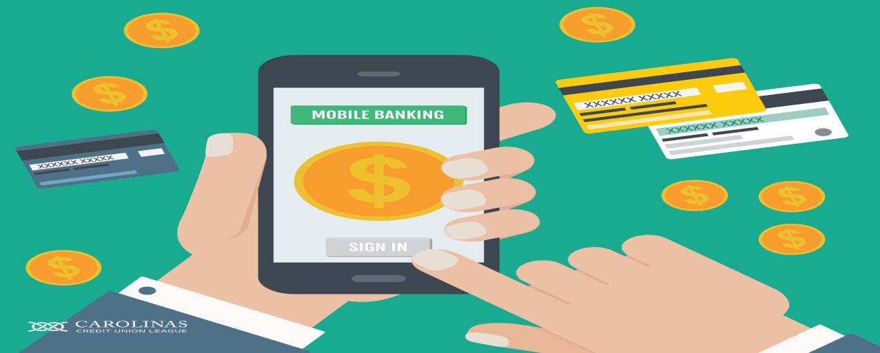
Portability:
Electronic banking also creates a more mobile bank for customers.
Mobile apps allow customers to check balances and perform routine bank transactions from anywhere they can get phone reception.

Slide 28
Cost Saving:
E-banking offers some cost-savings opportunities for customers. By paying bills online, you reduce the number of checks you have to write.

Slide 29
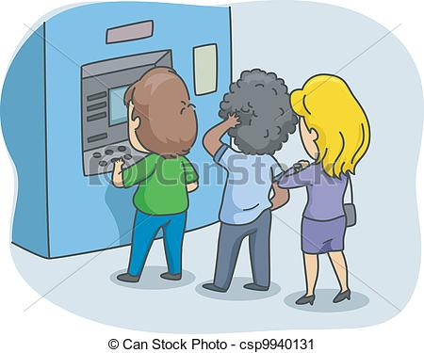
Traditional Verses Online Banking
Traditional banks are very expensive to run.
It has been estimated that banks can save around 50% on the cost of transactions through the use of on-line banking.

Slide 30
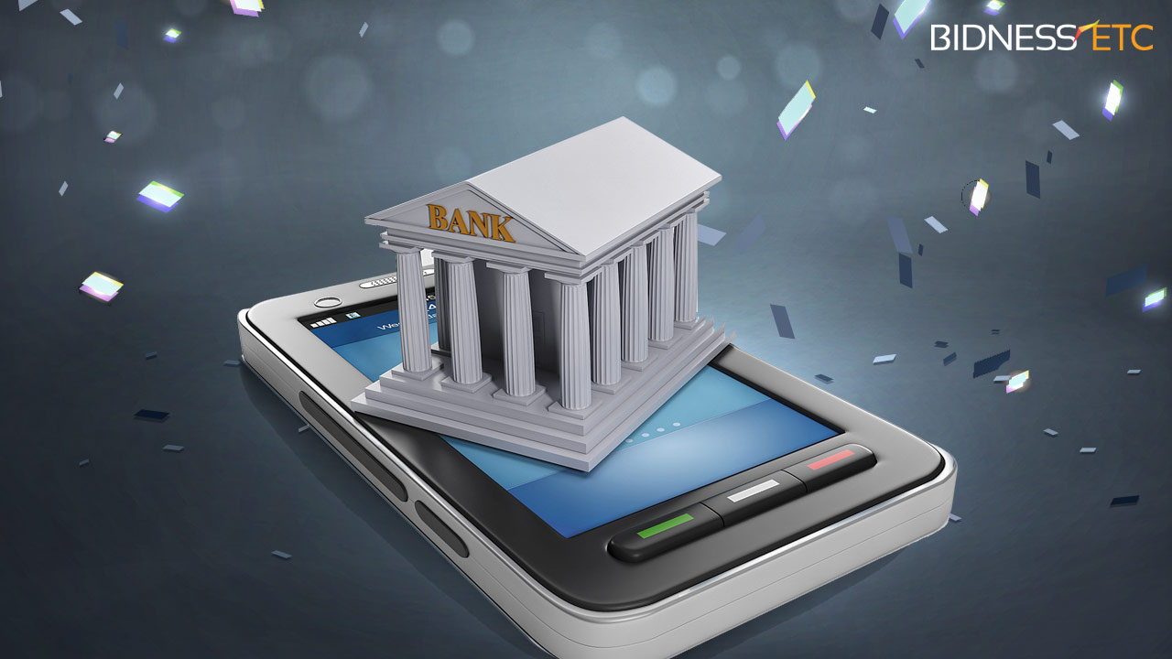
E-banking Expansion:
The use of e-banking has led to the expansion of banking industry, opening new avenues for banking operations.

Slide 31
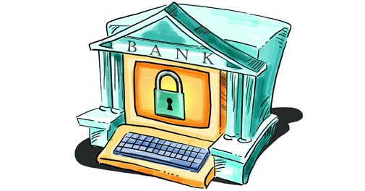
Avoiding Unlawful Practices:
The sense of being in an automated, electronically controlled and thoroughly monitored environment discourage many illegal and illegitimate practices associated with banking industry like money laundering, frauds

Slide 32
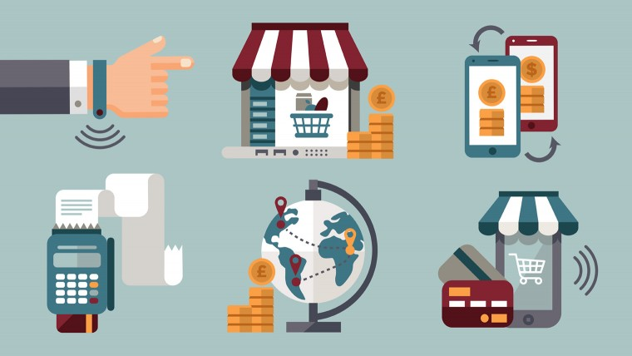
Benefit of Industry
Banks can minimize labor and supply costs by allowing customers to self-service certain types of transactions, and save money on paper and postage by sending statements over the Internet.

Slide 33
Issues in E-Banking
From producer side:
The producers are the bankers
Bankers are the people who lead the bank and design the policies
More issues of e-banking are following:
Security Issues
Necessity of the Internet
Customer Care Services
Narrow Market Base
Lack of Regulatory Framework
Security Breaches

Slide 34
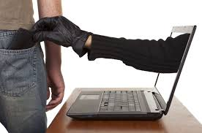
Security Issues:
While making online payments bankers are always concerned about the hackers and anti-social elements.
Hacking enables the unethical hackers to penetrate the accounts of online bankers, and spend their money.
Bankers are also aware about the hackers during transferring money from one account to another.
Availability of confidential information which is just secured by a user name and password, makes it vulnerable to such threats.
Banks try to make their sites secured by implementing latest network security software.

Slide 35
Necessity of the Internet:
For availing the benefits of online banking, one should have access to the Internet.
For e-banking one should own a desktop, laptop or PDA device, and an Internet connection.
This limits the usage of online banking, as sometimes it's almost impossible to have an Internet connection, to serve the purpose.
One might also face problems if the Internet connectivity breaks down during an ongoing transaction, or if someone eavesdrop his user name and password.

Slide 36
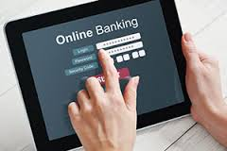
Customer Care Services:
Carrying out online transactions there are many instances when the banker might need help of a representative, from the bank.
Online banking, in which the banks provide customer care numbers, the bankers find it difficult to get their problems solved.
Sometimes there is a congestion in the network and they have to wait for some time, in order to talk to the bank's representative at the other end
Once the line is put through, one may either get somebody helpful and knowledgeable or may not, leaving him in a baffled and confused situation.

Slide 37
NARROW MARKET BASE:
Communication infrastructure and non-availability of internet facility to larger strata of population have been cited among the main issues faced by various commercial banks offering online banking facility to their account holders.
The banks, in this regard, need to start a comprehensive awareness program for their consumers informing them about the online products and services and the benefits of using these real-time facilities.
The employees are also needed to be properly trained for effectively managing the online portfolio of their bank.

Slide 38
LACK OF REGULATORY FRAMEWORK:
The regulatory environment for the banks to indulge into or offer online banking facilities is not propitious.
Availability of a proper regulatory framework will, therefore, encourage banks to develop and expand their online banking network and offer innovative products and services to their consumers on their branch network across the country.

Slide 39
SECURITY BREACHES:
By allowing the employees and consumers to access the bank's systems and applications through internet can create several security issue as well as unnecessary reputation risk for banks until otherwise properly monitored and secured.
Few stories of hackers draining online bank accounts in different countries are still fresh in our minds.
banks needs to deploy necessary security measures and required procedures to safeguard their virtual networks and core banking applications from hackers and disgruntled employees.

Slide 40
Issues in E-Banking
From consumer side:
The consumer are the customer of the bank
customers are the people who use the bank products and services.
More issues of e-banking are following:
Start-up may take time:
Learning curves:
Bank site changes:
Some online banks are more stable than others:
Not all online transactions are immediate:
Security:
Access:

Slide 41
Start-up may take time:
In order to register for your bank’s online program, you will probably have to provide ID and sign a form at a bank branch.
If you and your spouse wish to view and manage their assets together online, one of you may have to sign a durable power of attorney before the bank will display all of your holdings together

Slide 42
Learning curves:
Banking sites can be difficult to navigate at first. Plan to invest some time and\or read the tutorials in order to become comfortable in your virtual lobby.

Slide 43
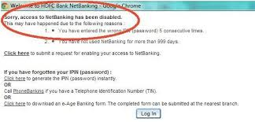
Bank site changes:
Even the largest banks periodically upgrade their online programs, adding new features in unfamiliar places. In some cases, you may have to re-enter account information

Slide 44
Some online banks are more stable than others:
Not all online setups are an extension of a brick-and-mortar bank. Some operate completely in cyberspace, without the benefit of a branch that you can actually visit if need be.
With no way to physically check out the operation, you must be sure to thoroughly do your homework about the bank's background before giving them any of your money.

Slide 45
Not all online transactions are immediate:
Online banking is subject to the same business-day parameters as traditional banking. Therefore, printing out and keeping receipts is still very important, even when banking online.

Slide 46
Security:
Security is by far the biggest concern surrounding internet banks, with consumers worrying that hackers will get into their account and spend their money.
. Banks are adamant that the sites are secure, but while there have been no reports of large-scale theft, there have been plenty about unwitting surfers stumbling across peoples' details.

Slide 47
Access:
The biggest day to day problem with internet banking appears to be access. You might find it difficult to get on to the internet at certain times of day - weekday evenings are the most popular.
The speed with which you access your account will also depend on the amount of memory your computer has or the speed of your modem.

Slide 48
E-banking _ The Future
Handling day to day activities e.g. managing their bank account, is made easier through the use of their computer and the internet known as internet or online banking.
Banks could conduct their business much more cost efficiently if it was all done through the internet, but not all customers are willing to forego the person to person transactions that they have been used to for so long.
Some people have not yet been able to put their trust in computers and the internet, especially when it comes to their money.
Use of internet banking can allow the customer to handle almost all their banking transactions online.
Customers are able to access their account balances, past and present transactions, transfer funds from one account to another, pay bills, look up checks, reorder checks, stop payments, complete loan applications, and make contact through messaging with bank staff members.

Slide 49
Continued..
It all is being able to do these things 24 hours a day, seven days a week, and without leaving their homes.
Customers will also realize a savings in time.
Banks have firewalls and security features on their sites that will guarantee complete privacy and that account information is visible only to the customer.
The customer sets up access to their online account by either choosing or being assigned a username and password.
Once the customer has logged in using their username and password, they will have access to their account information and will be able to see any transactions that have taken place as well as deposits, charges, and transactions that are in progress.
When the customer is finished, he or she needs to be sure to log off properly so that their information is safe and can't be accessed by anyone else.

Slide 50
Continued..
Internet banking has made it much more convenient for people to manage their money, and banks encourage its use.
As more and more people become increasingly familiar with the world of the internet and learn to place more trust in its security, the future of internet banking is looking brighter and brighter.

